Slide 1
Name: Swapnil Ghosh
Group: A2
Roll: 001911001067
TASK 12

Slide 2
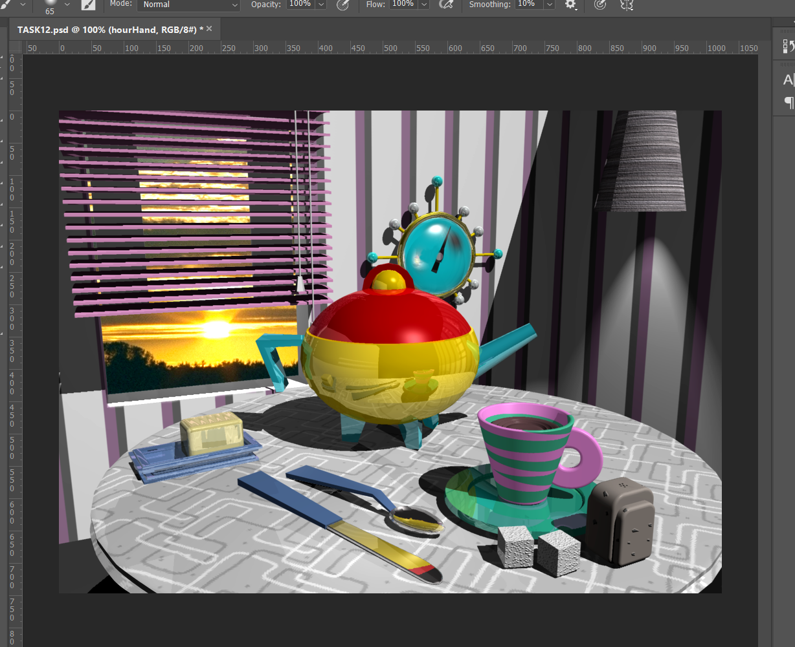
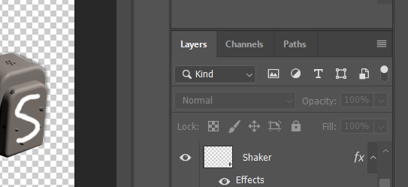
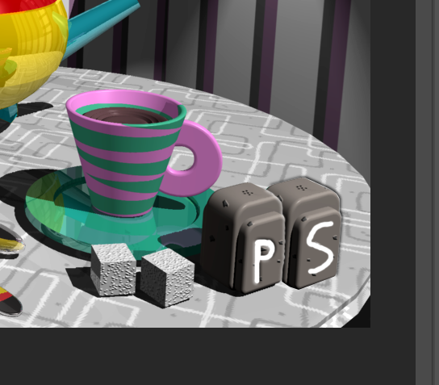

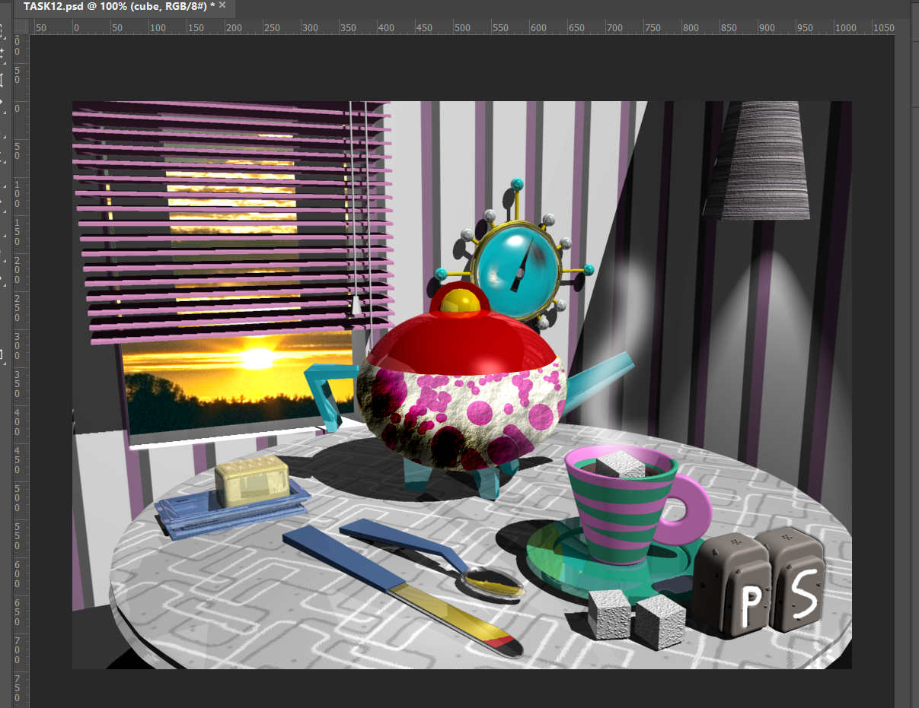
Step-1) Opened the file TEATABLE.TIF in Photoshop and reset all the tools .
Step-2) Make a selection of the shaker using Polygon Lasso Toll and copied it to the another layer named shaker.
Step-3) Deleted the left side of the shaker using the selection.
Step-4) Added the text P and S using the paintbrush tool, 5px hard brush and white as foreground color.
Step-5) Selected the sugar cube and deleted some portion from the cube to blend with the cup and added some effect using brush tool with foreground colour.
Step-6) Used the selection tool to select the base and saved the selection. Then opened the CLOUN.TIF and applied this selection operation and adjust the layers.

Slide 3

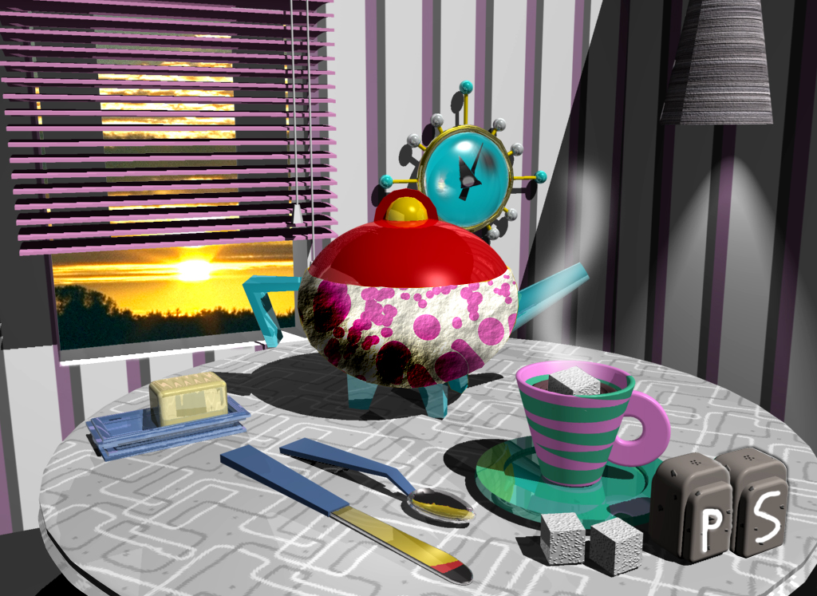
Step-7) Selected the clock hand using the Polygon Lasso and masked it.
Step-8) Used blue colour to remove the hour hand and using transform tool , changed the triangle direction to 11 o’lock.
Final Image

